Slide 1
I’m happy when…

Slide 2
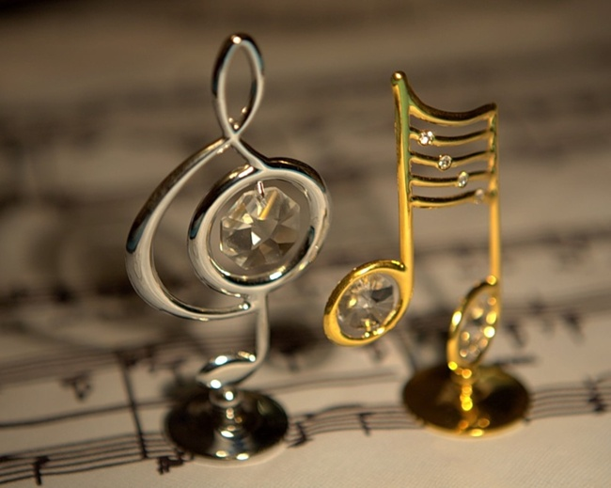
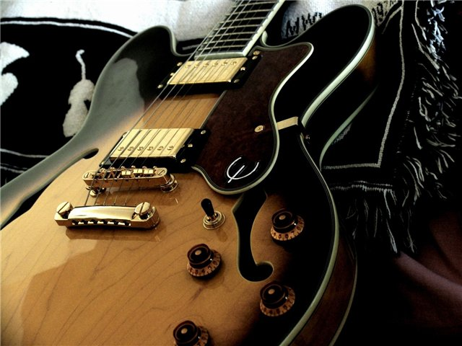
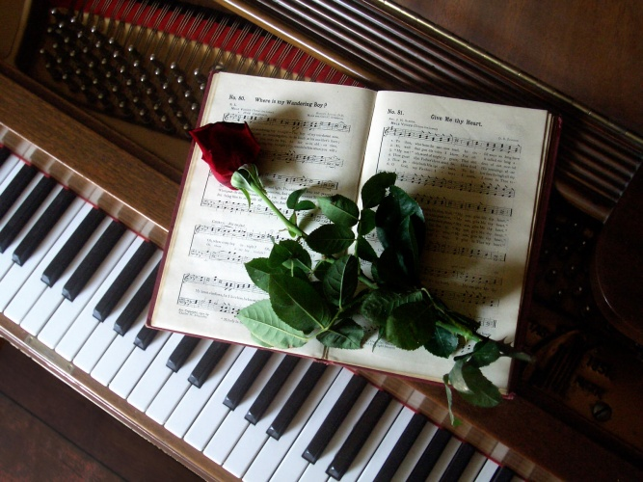
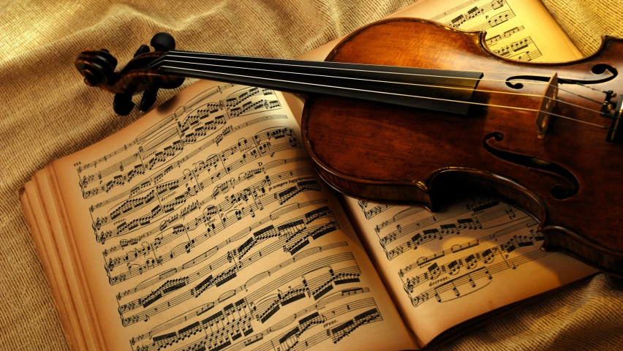

Slide 3
The Sounds
of Music

Slide 5
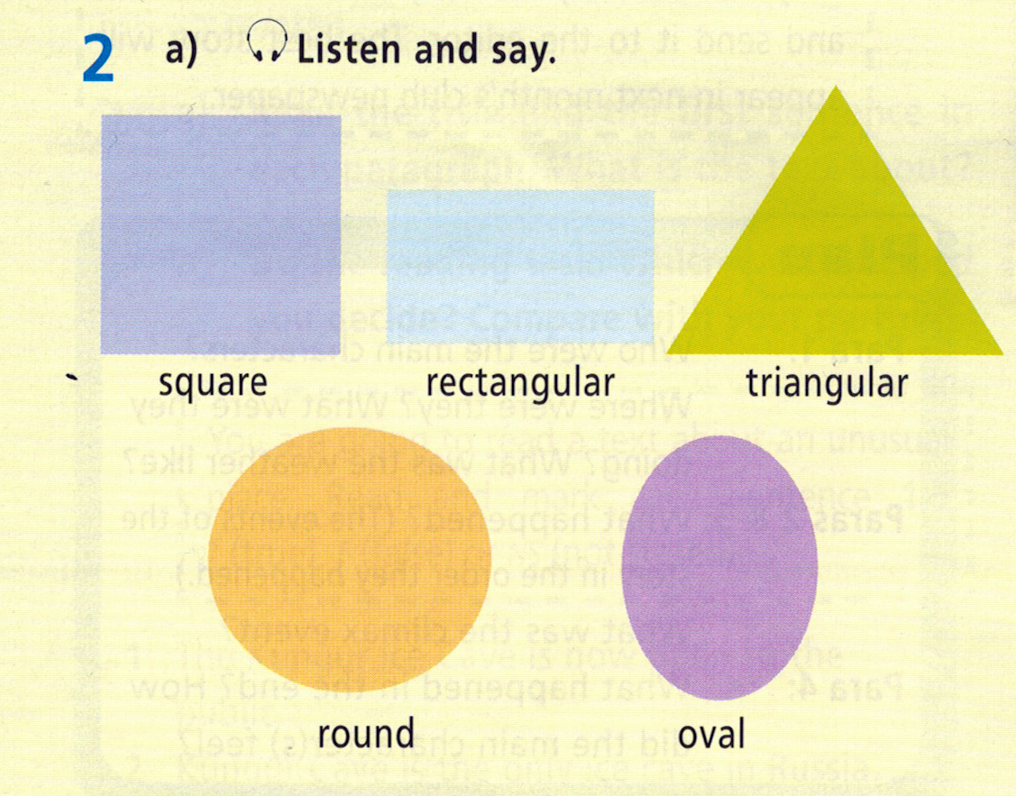

Slide 6
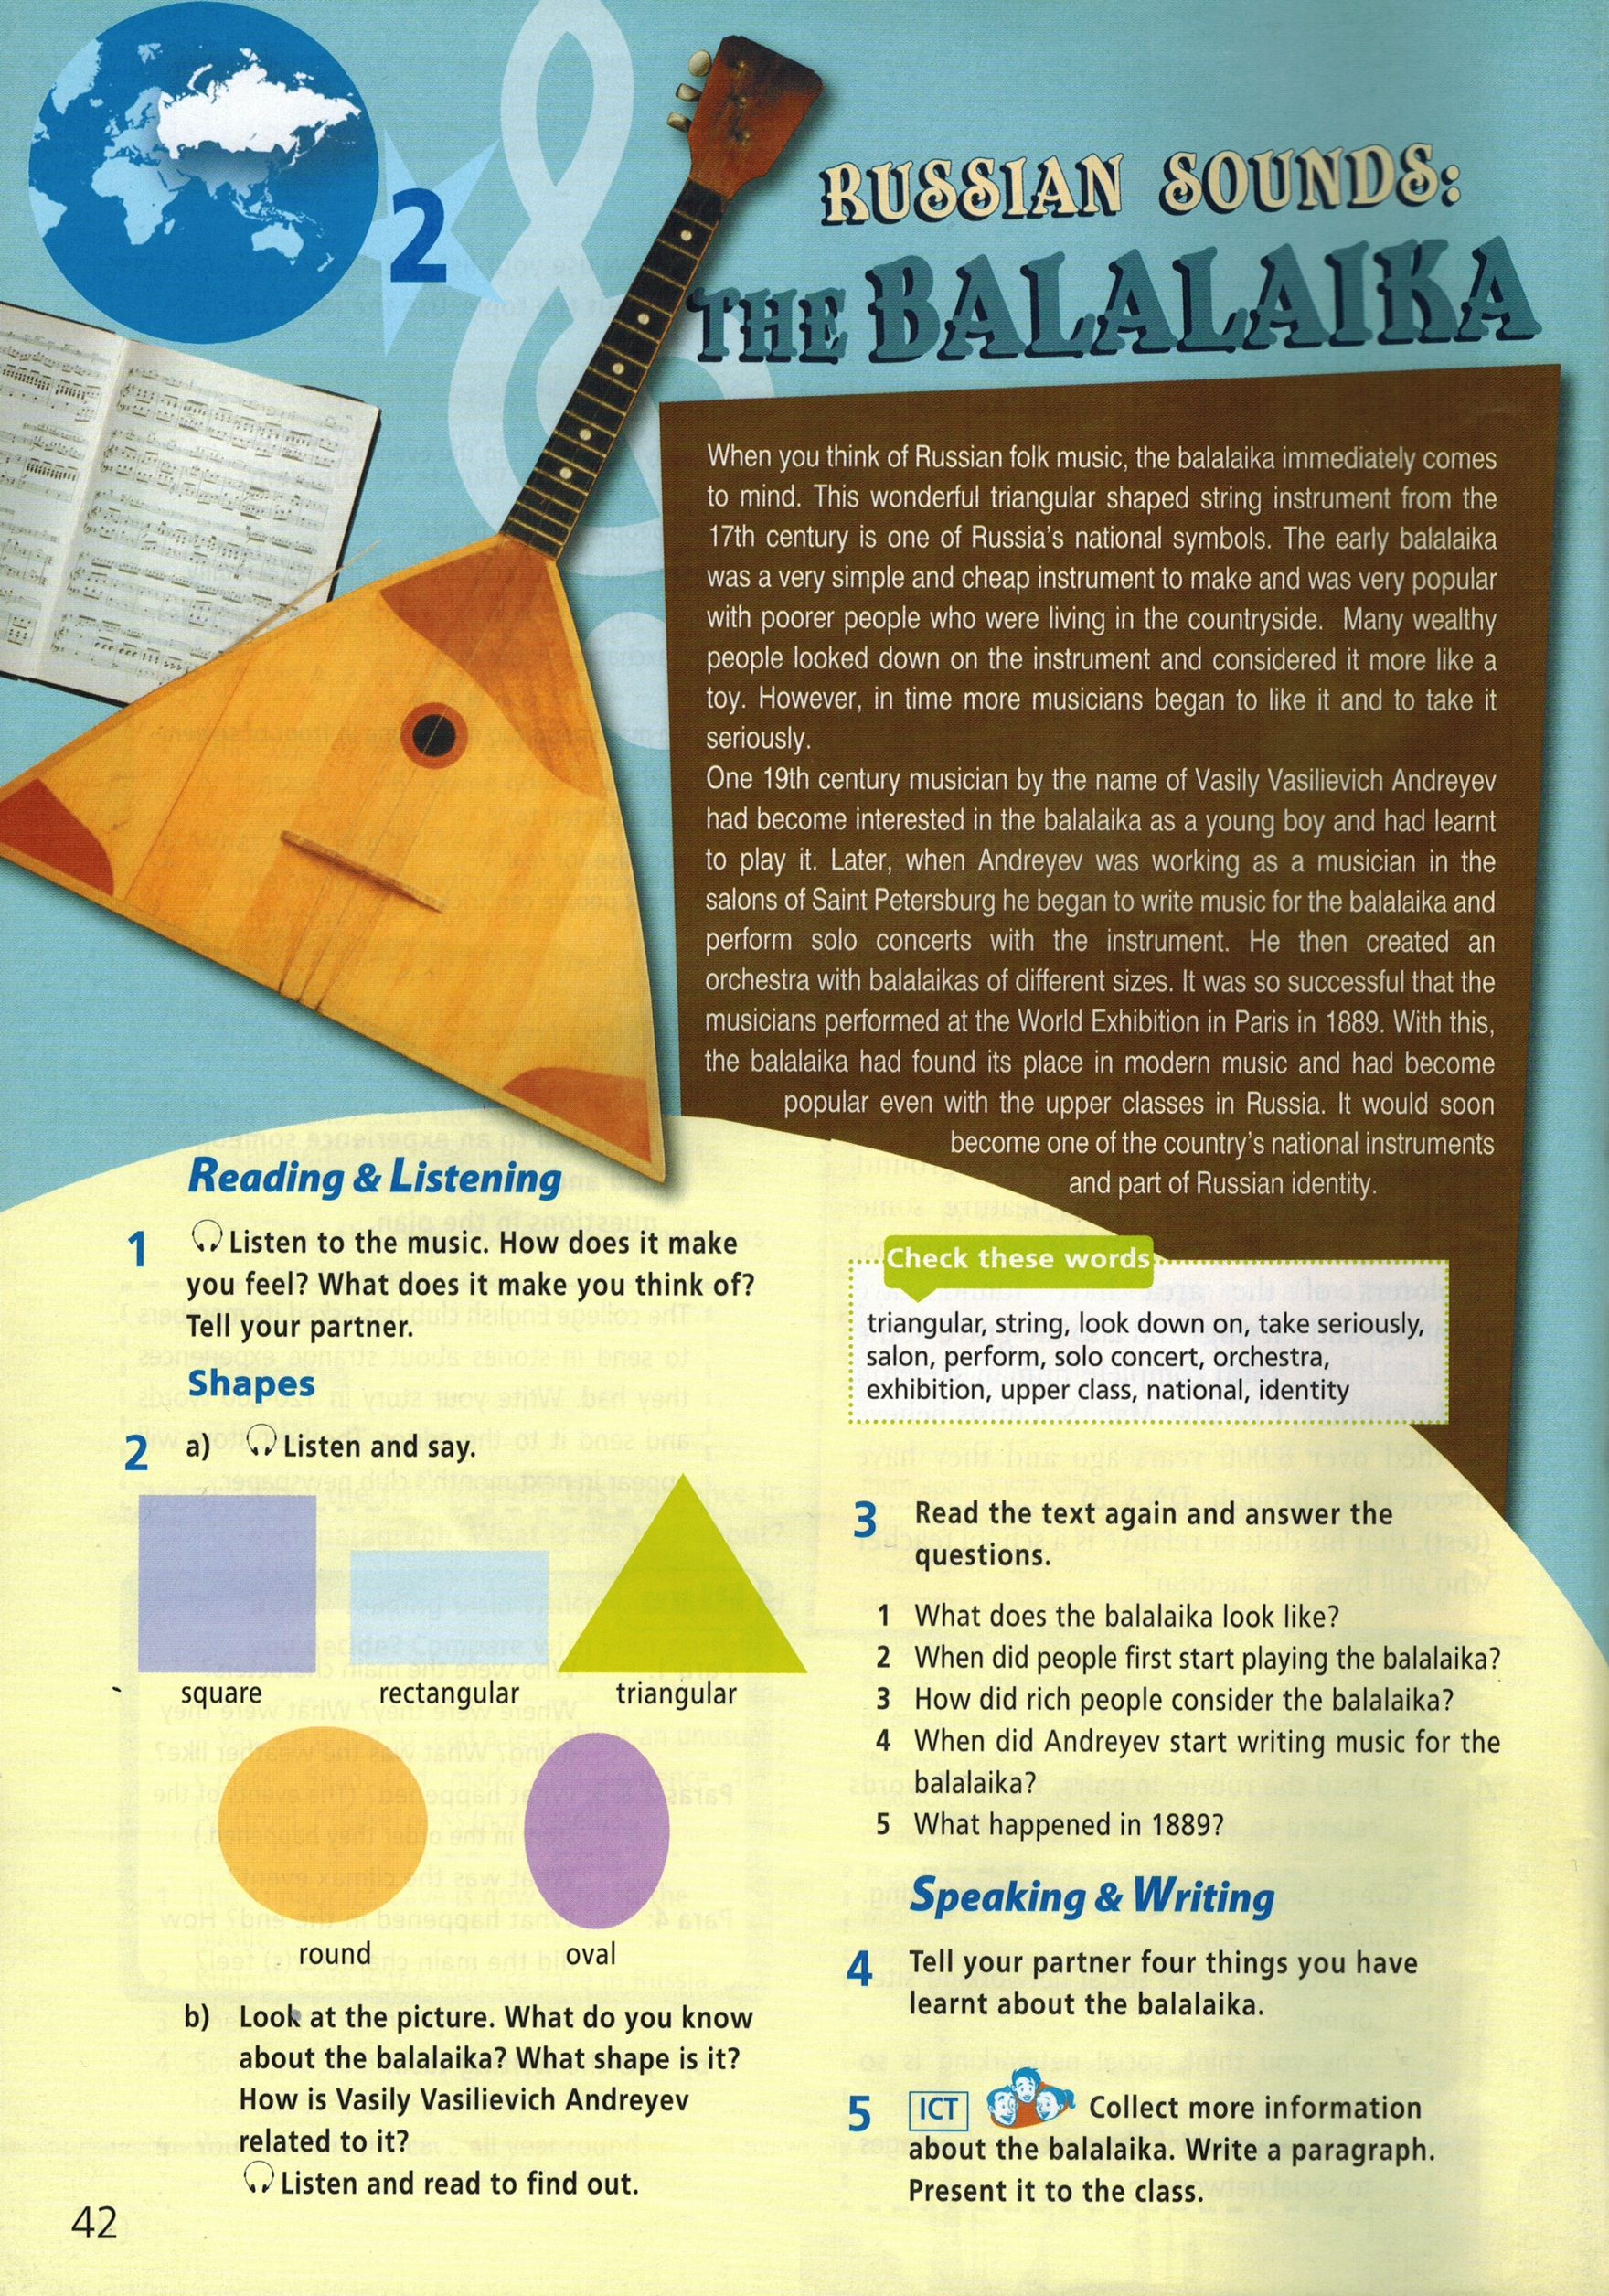

Slide 7
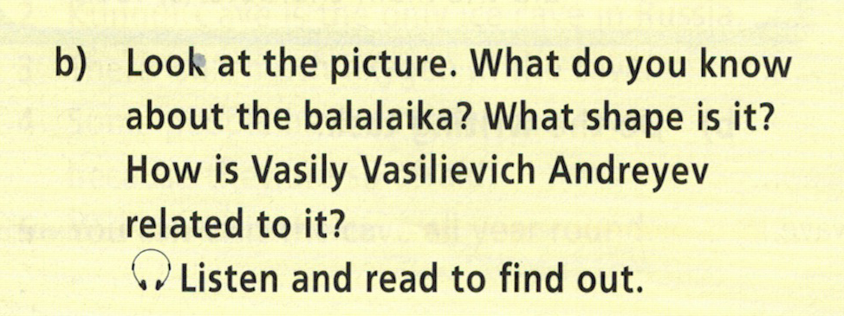

Slide 8
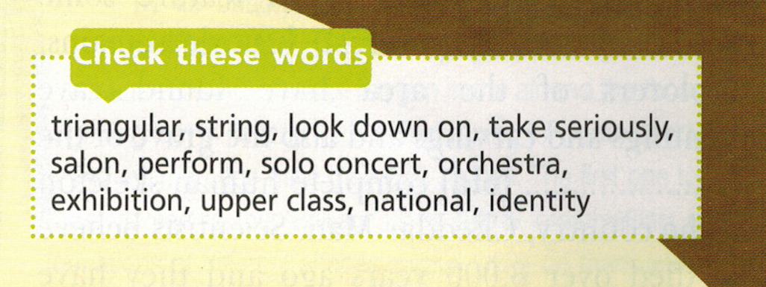

Slide 9
triangular
- a shape with
three angles

Slide 10
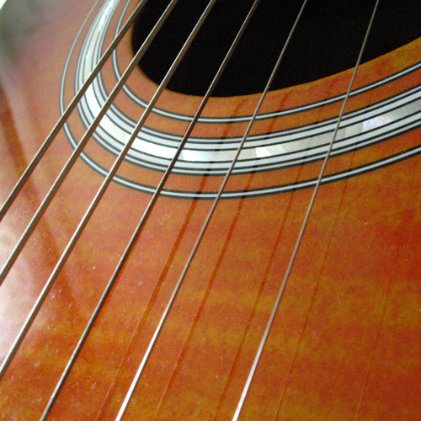
string
- a thick metal thread that helps some instruments to produce sounds

Slide 11
look down on
- to behave as if you’re the best

Slide 12
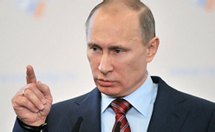
take seriously
- to consider smth very important

Slide 13
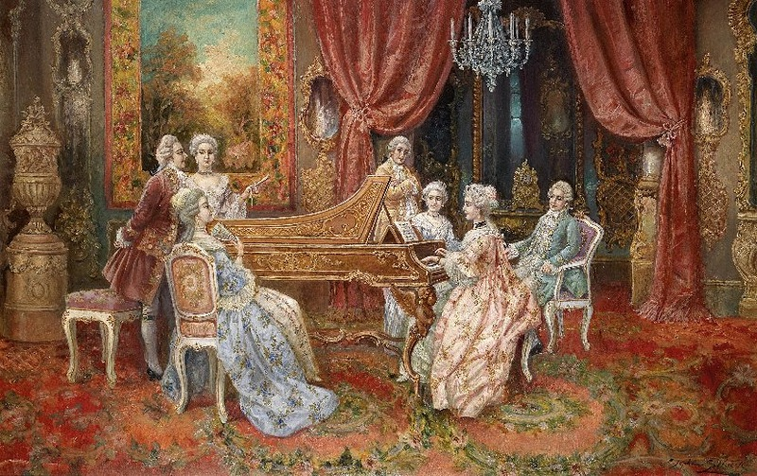
salon
- a place where music was played

Slide 14
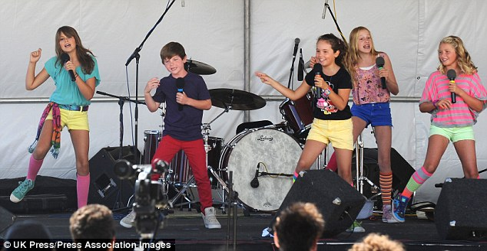
perform
- to sing, dance on stage

Slide 15
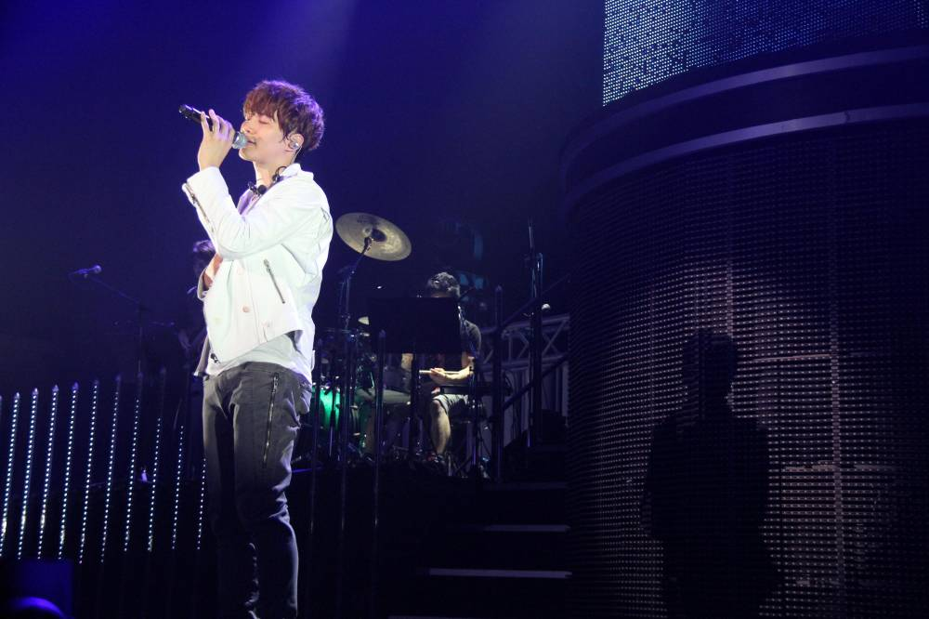
solo concert
- a show that is done by only one person

Slide 16
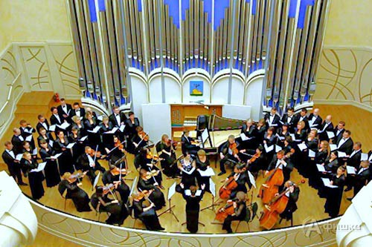
orchestra
- a group of people playing different instruments

Slide 17
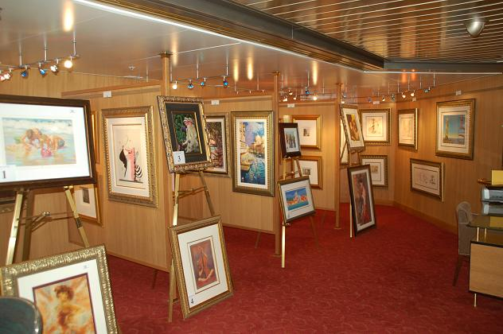
exhibition
- a presentation of different items (things)

Slide 18
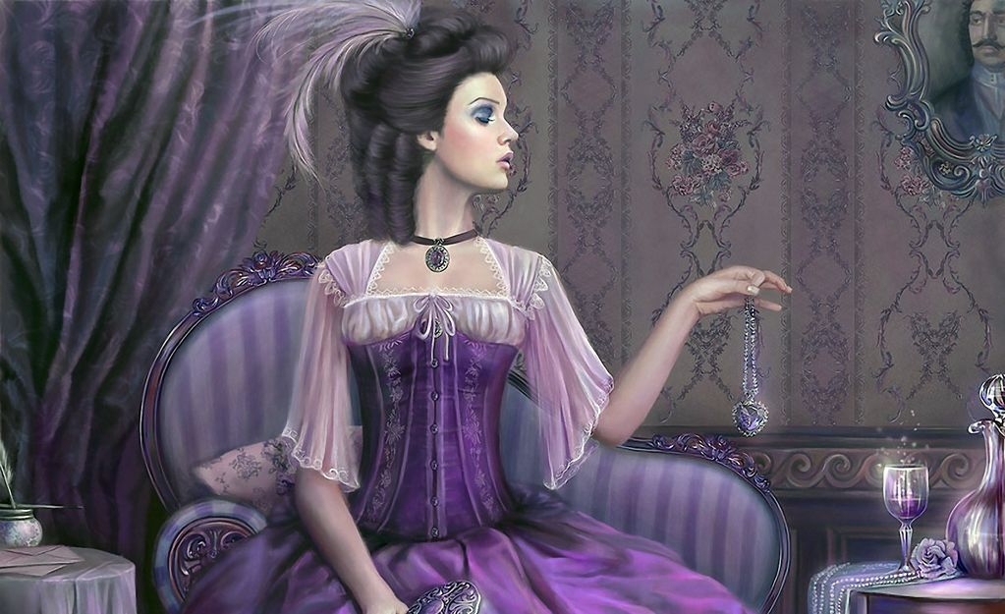
upper class
- a social group of people having political power and wealth

Slide 19
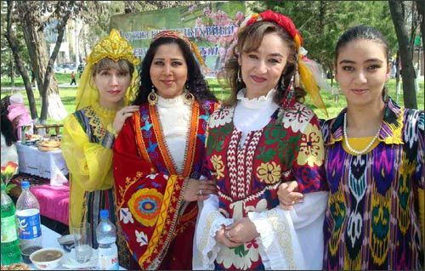
national
- related to some culture, country

Slide 20
identity - similarity

Slide 22
Musical instruments:

Slide 23
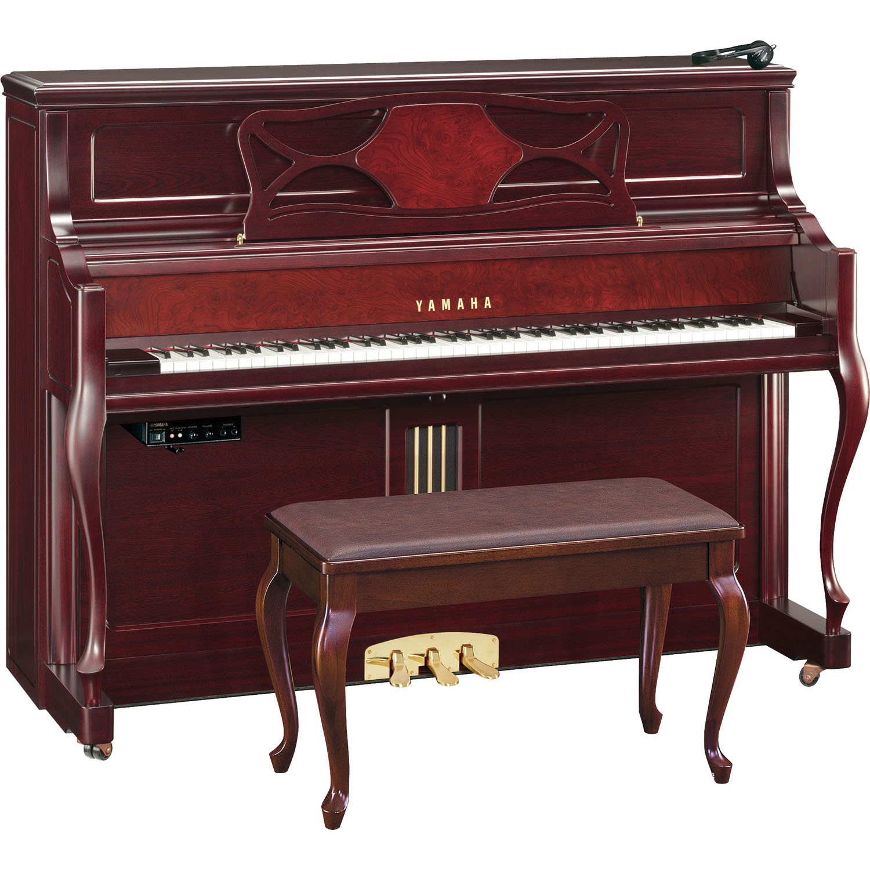

Slide 24
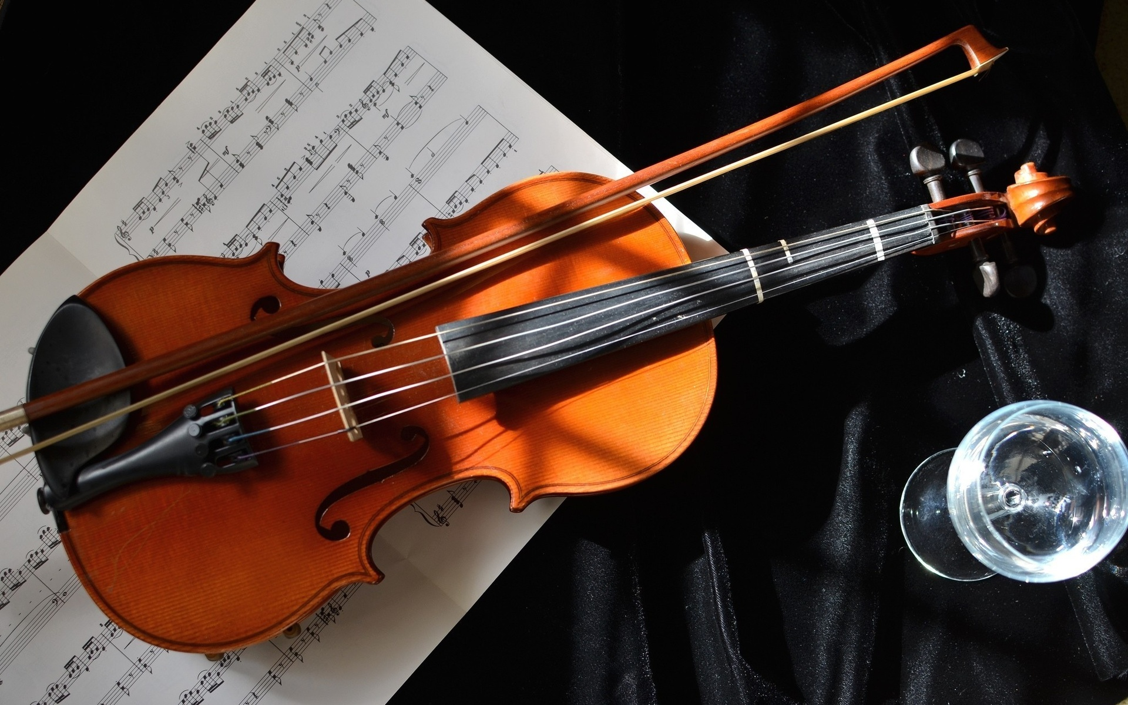

Slide 25
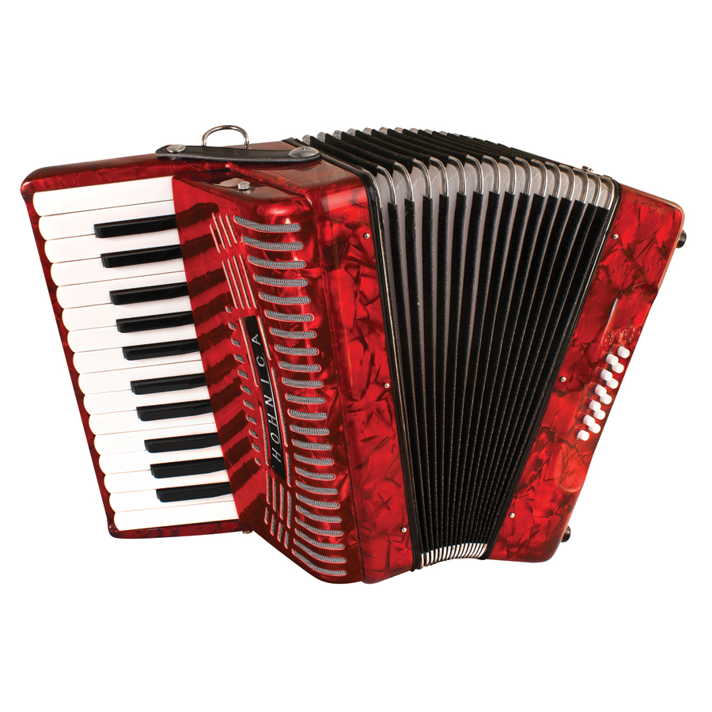

Slide 26
What have we done at the lesson?
Was the lesson interesting?
What was difficult?
What was new?

Slide 27
Thank you and goodbye!

